Slide 1
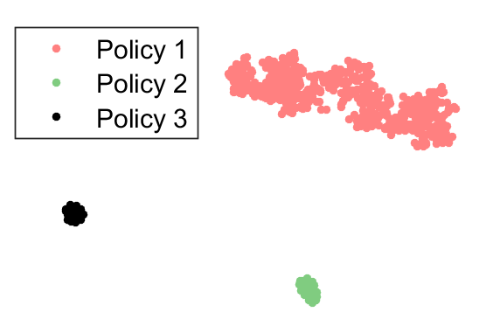
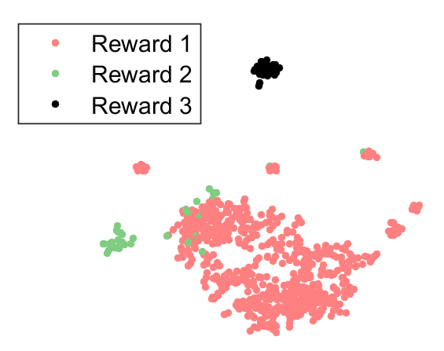
<Project Title>
<PI¹, PI², PI³>
<University¹, University², University³>
NEED & INDUSTRIAL RELEVANCE
PROJECT GOALS
OBJECTIVES
Fewer than one in five low-income individuals receive the legal help which they need.
To meet this need federal spending on legal aid needs to increase to $1.6 billion.
Demonstrate applicability of the Reinforcement Learning framework to assisting SRL’s
Increase understanding of how to represent human agents within an RL agent’s state space
Educate students in Reinforcement Learning application
Complete seminal research into digital assistants
Demonstrate usefulness of RL to knowledge services
Extend current research to identify an SRL’s objectives and needs (Rewards) based on their behaviors (Policy)
APPROACH (RESEARCH METHODS)
DELIVERABLES/OUTCOMES
IMPACT
We will work with Thompson Reuter to acquire relevant data sets in order to understand what SRL’s most need
Using this data we will identify the key statistical features that differentiate SRL’s with successful outcomes vs unsuccessful
With these features we will define a state space, action space and reward signal that we can train an assistive agent for
A framework for a continually learning digital assistant
State and action definitions for decisions and planning
Source code for digital assistant used in experiments
Increased successful resolutions for all SRL’s
Increased hourly rate for attorneys to serve
Decrease in the pressure on the US Court System
New model proven which can be used in many industries
Data
MDP
Source

